Slide 1
Extract, Transform, Load: Transferring Surveys to the Corporate World
Iain MacKay
X-MR Limited
ASC conference, November 2021
Notes:
Good morning everyone.
When preparing this presentation I was reminded that the last time I presented at the ASC was with my friend and colleague Geoffrey Roughton, who sadly passed away in January this year.
Many here knew Geoffrey and his passion for innovation in survey research and technology, which spanned the 1950s to the present day, moving from punched cards to video focus groups. I miss him particularly at occasions like this.
While thinking of the past, I retrieved the programme of the first computers and surveys event I attended, hosted in 1975 by the Study Group for Computers in Survey Analysis which morphed into the ASC we have today.
Two papers from the programme are still relevant, chasteningly so in fact. Andrew Westlake ventured that a standard for transferring survey data and metadata between applications would be a good idea, and Elizabeth Oxborrow talked about the then nascent database systems and how social scientists should engage with them. I will revisit that problem now!

Slide 2
To be covered…
Key takeaways
Exercise for the reader
A little history of databases
How surveys fit in the data analysis world
How to simplify survey analysis with databases
How to integrate survey data with the wider world
Further reading
Notes:
I’m going to talk about bridging from survey research to corporate business intelligence and data science through the medium of relational databases.
I promised in the abstract for this talk that I would present real and actionable suggestions, and so I have prepared a Google Colab notebook demonstrating some of the methodology I propose, which you can look at or even execute as we proceed.
I’ll mention some key history of relational databases before discussing how surveys fit in the wider world of data analysis and how relational database methods can simplify your own survey analysis work; in particular, how you may integrate your survey data with corporate data systems.
This is a big subject, worthy of a workshop rather than a presentation, but I hope today I may persuade some of you to explore these ideas for yourselves.

Slide 3
Key takeaways
Survey data typically present as a denormalised un(der)documented relational database
Difficulties with analysis and interoperability arise from this
Normalise your survey into a relational form and the difficulties abate
Have a look at:
Tidy dataset concept - gateway to data science and ML
Repeatable Analytical Pipeline
Databases used to be hard to use for ad hoc analysis – not any more
Notes:
So these are the key points I’m eager to convey today.
Though the motley CSV and SAV files we often receive as the feedstock of our analysis work may not look it, a survey file prepared by modern collection systems is actually a well-concealed relational database.
Difficulties in analysing survey data arise from this concealment and our initial task is to expose the relational structure in our data. Once this is done, it becomes easy to analyse.
I also want to use this platform to promote two concepts that I think deserve much wider exposure.
One is the concept of a “tidy dataset”, which once articulated is a great clarification of the work that we do preparing our data for analysis.
The second is the concept of a Repeatable Analytical Pipeline, an idea which in my opinion at least is well overdue.
Finally –databases used to be hard for ad hoc work, but not any more!

Slide 4
Exercise for the reader
Open the Colab notebook at https://s.x-mr.com/3kna46f
Browse it
Or to run it:
register with Pew at https://www.pewresearch.org/
download the 2019 Global attitudes SAV file
Upload it to your Google Drive a/c
In Colab, click Runtime/Run all
Notes:
This notebook should be legible and indeed executable on any device with a modern browser. You will need to use a Google Drive account if you want to execute it.
I’d be grateful for any feedback and suggestions and if anyone is interested to see the process continued with further normalisation and visualisation of this interesting survey so generously contributed to the public domain by Pew Research, I’ll be happy to use it as the first posting in a computational blog – or is that a clog?

Slide 5
Concept of database
"Sexual intercourse began
In nineteen sixty-three
(which was rather late for me) -
Between the end of the "Chatterley" ban
And the Beatles' first LP"
Philip Larkin, Annus Mirabilis
Relational databases began in nineteen seventy-one,
With the publication of E F Codd’s seminal paper,
“A relational model of data for large data banks”
https://www.seas.upenn.edu/~zives/03f/cis550/codd.pdf
Structured Query Language (SQL) was designed and implemented
by IBM based on these ideas, first appearing in 1973.
Key to relational data modelling is Codd’s “3rd normal form”
1NF: each row has a unique key and each column holds just one value of just one type
2NF: 1NF + no redundant columns that can be calculated from the other columns
3NF: 2NF + every non-key column in a table must depend on the value of the key
From this come the concepts of “normalisation” and “denormalization”
The key, the whole key, and nothing but the key, so help me Codd."
Notes:
Some innovations are revolutionary in that they separate two things that were formerly inseparable and allow them to follow independent paths.
Philip Larkin’s poem about the invention of the contraceptive pill describes how sex could be recreation or procreation without as before necessarily being both at the same time.
Similarly, Edgar Codd’s 1970 paper introducing the relational data model showed how when you designed a storage protocol for data you did not need to specify at the same time exactly how you would query and update those data. This separation of physical storage and logical model of data had been introduced with the COBOL language but it was Codd who demonstrated its true potential value.
Codd was an interesting character in himself – born in Dorset, served as a pilot in the RAF during World War 2 before starting an academic career that led him to a research position in IBM where he developed his data theory.
Apologies for violating the presentation principle that I should not present text to read while saying different words. Please treat the slide as a little cheat sheet of the key principle of relational data, that you should be normative first and pragmatic after.

Slide 6
Data analysis universe
Survey analysis
Business intelligence
Data science
Notes:
I’ve shown three main groups in the data analysis community.
Survey analysts, the present company, I see as creative and pragmatic but constrained by budget – somewhere like Shoreditch is our natural milieu.
Data scientist are more sophisticated and aloof, while the business intelligence community have big budgets and fine suits.
Each group has its own priorities, preferred tools, and to some extent their own vocabularies but underlying them all is essentially the same problem domain.

Slide 7
What makes survey data so different?
Sampling – weights and universe
Survey datasets are small and complex rather than large and simple
Categorical variables (though some DBs have enums now):
Labels for presentation
Codes for ordering and identity
Multiple response questions
Grid questions
Filtered bases
Notes:
I’ll whizz through this chart because it’s restating matters familiar to us all.
Maybe we’ve all had discussions with database enthusiasts who assume questionnaire data is as easy to model as most commercial data.
Over the years I’ve come to realise that none of these present real difficulties in relational modelling if you are sufficiently radical in your approach.
The only real difficulty in my opinion is that most commercial databases have lifetimes measured in years or decades, while ad hoc survey databases have lifetimes of little more than days, despite being each as complex schematically as many commercial systems.
Production database systems are focused on performance at scale, rather than on simplifying the database schema preparation.
The priorities for most survey research are the other way round.

Slide 8
What makes survey data so difficult?
A typical modern survey dataset (unless it has a Triple-S XML version 3 schema), unlike a database, is devoid of structural metadata or often any metadata at all, leaving the analyst to program for themself:
Filters: unasked optional questions left as blanks
Repeated fields, representing:
Multiple questions
Bit string
Spread
Grids – fields for each row
Hierarchical data: sections repeated, e.g. for individuals in a household
Categorical data:
Answer ordering (codes versus labels)
Value labels in the data record
No explicit value list
Notes:
What makes survey data so difficult to handle is precisely the fact that they have a complex schema, and that unless delivered with a Triple-S XML level 3 description, the analyst has to manually reconstruct much if not all of the schema information, often with scant documentation.
A typical survey data record delivered today, like the one examined in the notebook accompanying this talk, has hundreds of data fields, many of them empty.
Unasked optional questions are left blank, making it impossible to distinguish informants who are filtered from informants who gave no answer.
There are many repeated fields, typically for each expected possible answer to a question, each brand in a product field, each household member up to some generous limit, with hardly any populated with data.
Something is clearly wrong here. Before exploring these data the analyst has to specify some treatment for each of these fields.
The actual questionnaire though as presented to each informant is often very simple - tens not hundreds of questions.
A normalised relational model of the questionnaire is also succinct – with a size more in proportion with the researcher and informant’s perception of the questionnaire.
Once you set your objective as identifying the schema of this database and using the data fields to populate it, there is a panoply of tools - open source tools too, to facilitate your work. Your reward is a database that is easy to explore and analyse.

Slide 9
What has made databases hard to use for surveys?
Formerly:
Expensive software
Slow for analytics
Cumbersome to deploy
Now though:
Improved hardware
Design features supporting analytics (e.g. column databases)
Powerful open source systems:
SQLite – desktop, data publication
Postgres + Docker – interoperability
Notes:
For many years databases were managed with expensive proprietary software on very expensively configured computers.
They were optimised around the role of capturing transactional data in real time, and not well positioned for analytical processing which often requires full table scans.
This led to a genre of management information software designed around analytical processing, to provide business information for decision makers, and concepts like data warehouse and data lake dealing with snapshots of the transactional data.
The expense of this system meant that the kind of access we need for survey analysis – each project its own database with its own schema – was tightly guarded by an elite priesthood of Database Administrators.
Now things have changed.
Greatly improved hardware means that for survey-sized databases even full table scans require trivial computational times.
For much larger datasets there are databases with exotic internals (column stores for instance) that expose a familiar SQL interface to the world.
Last but not least, there are extremely powerful open source systems. I’ve signalled out Postgres, which can now be configured in the cloud in minutes, and SQLite which is by far the most widely deployed relational database implementation in the world. Probably every device in this room contains tens of instances of SQLite.

Slide 10
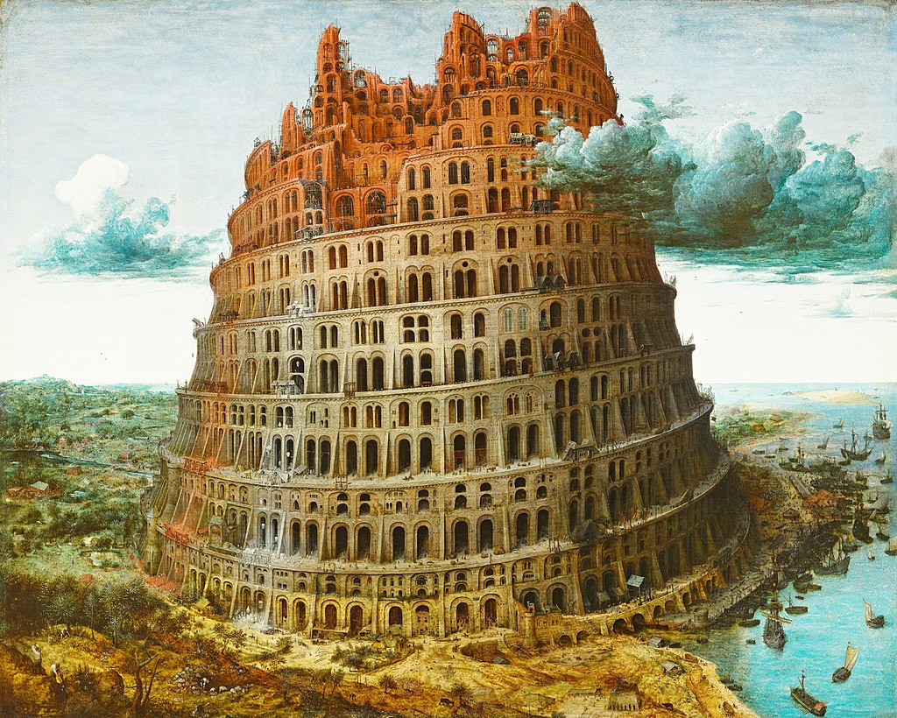
Data analysis vocabulary
Survey analysis | Data Science | Business Intelligence
Data cleaning | Extract, Load
Recoding | Feature Engineering | Transform
Specwriter | Data Scientist | Data analyst
Record | Observation | Table
Question | Variable | Column
Codeframe | Levels | Dimension
Multiple/grid | Vector | Repeated group
Cross-tab | Contingency table | Pivot table/cube
Multivariate analysis | Dimensional reduction, machine learning
Notes:
I mentioned differences in vocabulary between the different analytical communities.
While this presentation may seem a little facetious - personally I find “Feature Engineering” an absurdly hyperbolic characterisation of a basically mundane activity -
I think it is important to recognise that the differences in vocabulary don’t reflect differences in the underlying concepts.
Recognising the essential similarities helps us see the path to bridge our dataset over the gap between these different communities.

Slide 11
Data analysis technology
 | Survey analysis | Data science | Business Intelligence
Model/ Metadata | inconsistent, incomplete, proprietary, primitive - except Triple-S | Serialisation formats for Dataframes e.g. Parquet, Avro, | Relational/SQL
Software | Proprietary specialised tools | Open source R & Python ecosystems | Analytically focused databases e.g. Bigtable, Snowflake, Redshift Presentation focused analysis tools e.g. Tableau, Power BI, Data Studio, Mode
Notes:
This chart exposes the weakness of the survey analysis space compared to the other communities.
Although these communities do not have a mutual consensus about data technology, both have quite pervasive de facto open standards and there is a lot of transferability of data and skills within each of them.
When I describe survey data and metadata modelling as “inconsistent, incomplete,proprietary and primitive” I don’t think I’m being unfair – yes SAV files, I’m talking about you!
Fortunately, there is a way forward.

Slide 12
Tidy data
Tidy data is a concept introduced by Hadley Wickham, prominent in the R community, in this excellent paper:
https://vita.had.co.nz/papers/tidy-data.pdf
Wickham, H. . (2014). Tidy Data. Journal of Statistical Software, 59(10), 1–23. https://doi.org/10.18637/jss.v059.i10
Wickham demonstrates how data sets can be normalised/tidied using three operations that he terms:
Melting
Splitting
Casting
Notes:
The term “tidy data” has been in currency for several years now, but I confess I had not seen it until recently – perhaps it’s an R thing.
We knew a tidy dataset when we saw one, but before Wickham we might have struggled to articulate our reasons. Equipped with the insights from his paper we can make such judgements objectively, and we have some verbs for the actions we need to take to tidy incoming messy data.
Some of us may recall or still use the terms “explode” and “implode” which are roughly equivalent to “melting” and “casting”.

Slide 13
Tidy data
Tidying a survey splits it into many connected datasets/tables.
I.e. A tidy survey IS a relational database
Notes:
Wickham makes the point that a tidy dataset is akin to a database relation in 3rd normal form.
Since a survey dataset normalises into multiple tidy datasets with fewer columns and more rows, it follows that a tidy survey is, in fact, a relational database and might as well be represented and transferred as such.

Slide 14
Now that we have “tidy data” in our vocabulary…
Tidy data good, messy data bad
Programs have inputs and outputs
So there are good programs and bad programs:
Messy in, tidy out – good
Tidy in, tidy out – good
Tidy in, messy out – bad
Messy in, messy out – bad
Is your program good, or bad?
Notes:
Wickham emphasises the importance of tidy outputs as well as inputs.
Outputs receive much less attention than input but particularly for statistical and machine learning tools the ability to use an output as an input for further processing can be very useful.
Note that SQL is good in this respect – the result of a SQL query is itself a table.

Slide 15
How do we normalise/tidy a survey dataset?
Filters:
Construct a new table for the questions in each filtered base, using the questionnaire id as primary key for each.
Remove the corresponding questions from the main table.
For each value list:
Construct a new “dimension” table with a row for each possible answer recording its code and label. Code is the primary key of this table
Often there are fields associated with each category in a list (bitstring multiple variables, grids). In this case:
create a second table with its primary key being the combination of questionnaire id and answer code.
Add a column to this second table for each multiple question or grid question using the list.
Remove the repeated fields for the multiple or grid from the main table.
For each repeated section, e.g. for each child in a household, spread multiple variable:
Construct a new table with the questionnaire id and section sequence number as primary keys
Put the fields of each section into separate rows in this new table
Remove the fields for each section from the main table.
In the event of nested hierarchies, these rules should be applied recursively to each collection of fields that is extracted.
Notes:
Earlier I mentioned some of the questionnaire features that lead to a multiplicity of data columns, and this slide shows recipes for tidying them.
Do try these at home!
Given rich enough metadata (for instance triple-s XML version 3) these conversions can often be made entirely automatically. The less metadata, the more manual work is required but armed with our new concepts of melting, splitting and casting, and the scope of the Python ecosystem, even the largest surveys do not present a great challenge.
In fact the greatest benefits of moving a survey into SQL are found with the most complex (multinational, longitudinal) and specialised (media, diary) surveys.
The transformation work from legacy data formats is typically a matter of days and you then have a database with great analytical and export flexibility. A gift that keeps on giving.

Slide 16
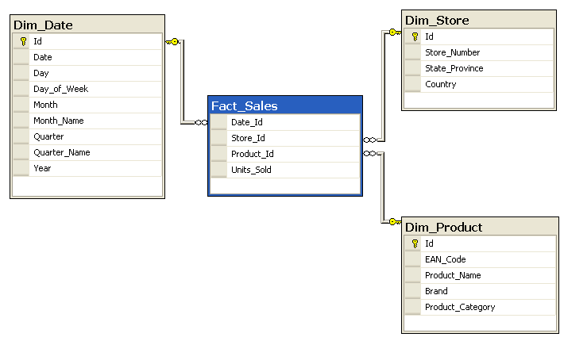
Dimensional analysis – “star” schema
Survey data record is a “fact table”
Categorical variable value lists are “dimensions”
Foreign keys
Dimension tables
Category labels and scores are dimension attributes
Weights, volumes, scores are “measures” to be accumulated
Fact table
Measure
Primary key columns of dimension tables join foreign key columns of fact table
Category codes join fact table to their dimension table
Dimension attributes
Notes:
For many purposes, particularly cross-tabulation, it is convenient to use the terminology introduced with Online Analytical Processing (OLAP) systems in the 1980s and 1990s.
This example shows a typical OLAP presentation of some sales transaction data.
Our tidied survey database will be constructed in the same style.
Once your answer lists (now termed dimensions) each have their own table (dimension table) and the answer codes in your main record have become foreign keys into what you now call your “fact table”, you have created what is called a “star” schema (“snowflake” schemata are a refinement).
Your fact table contains dimension keys and measures, which are units of accumulation.
In business intelligence applications these are units sold,
unit price etcetera used to derive total sales, average price and other aggregates.
In surveys we have lots of questions, so lots of dimensions but very few measures, sometimes only counts, often weights and occasionally quantities like satisfaction scores.

Slide 17
Dimensional analysis – building a “cube”
SELECT
P.Brand, S.Country AS Countries,
SUM (F.Units_Sold)
FROM Fact_Sales F
INNER JOIN Dim_Date D ON (F.Date_Id = D.Id)
INNER JOIN Dim_Store S ON (F.Store_Id = S.Id)
INNER JOIN Dim_Product P ON (F.Product_Id = P.Id)
WHERE D.Year = 2020 AND P.Product_Category = 'tv'
GROUP BY P.Brand, S.Country
ORDER BY P.Brand, S.Country
Dimensions being cross-tabulated
Measure(s) being accumulated
Filter on combination of dimension attributes
Country within Brand
Notes:
Now we have our fact and dimension tables we can build cross-tabulations.
This shows SQL building a filtered cross-tabulation of units sold by country within brand.
In production systems of course you construct your SQL from templates, it’s never necessary to write it out in full as we see here.
You can see that it extends easily to more dimensions – hence the name “cube” for the tables resulting from queries like this.
Btw this OLAP model was an explicit inspiration for Geoff Wright and myself when we designed XtabML – we envisaged a pipeline from cross-tab to a cube represented in XtabML onwards to a visualisation system, decoupling the analysis from its presentation.

Slide 18
Building bridges
Survey analysis
Relational databases
CSV files
Postgres
Bigtable
Business intelligence
Stata files
SQLite
Snowflake
PowerBI
Mode
SQL server
Oracle
SAS files
SAV files
Data studio
SQL Alchemy
Tableau
Data science
pyreadstat
et al
pandas
Triple-S files
Notes:
Finally the most important part.
The Python ecosystem provides the bridges we need between the three domains.
The pandas dataframe is extremely versatile and pervades all of the Python data science and machine learning tooling.
Two wonderful libraries provide the bridges we need. pyreadstat captures survey data in legacy formats like sav and stata (on the left) and converts their data to dataframes. Other libraries exist for CSV, Excel and less common formats.
Once you have a dataframe you can use pandas features to divide it into multiple dataframes corresponding to relational tables, that you can then deliver to the relational database world using SQL Alchemy.
SQL Alchemy does all the heavy lifting of creating your SQL table, index and foreign key definitions and then injecting them into your database platform of choice. The notebook I provide demonstrates the start of this process.
Once you have populated a database with your survey then all the major presentation and dashboard tools in the business intelligence space (on the right) can introspect your database schema and start constructing dashboards for you, just as they do with any other database you present to them.

Slide 19
Repeatable Analytical Pipeline (RAP)
Applying modern software engineering practices to survey analysis workflow
Introduced by GSS
Read more please at https://gss.civilservice.gov.uk/reproducible-analytical-pipelines/
Notes:
This is off-topic, but I feel it’s such an important innovation from such an influential source that as many people as possible should be aware of it and hopefully become enthused.

Slide 20
Conclusion
Further information:
Iain.mackay@x-mr.com
linkedin.com/iainm
Notebook at https://s.x-mr.com/3kna46f
This presentation is dedicated to the memory of Geoffrey W Roughton, a pioneer of computing in survey analysis, 1929-2021
Notes:
That’s it.
You can escape the straitjacket of legacy survey systems and the metadata-free datasets coming from much online research.
Thank you for your attention.
Try it now!

